Slide 1
Active Reading Strategies

Slide 6
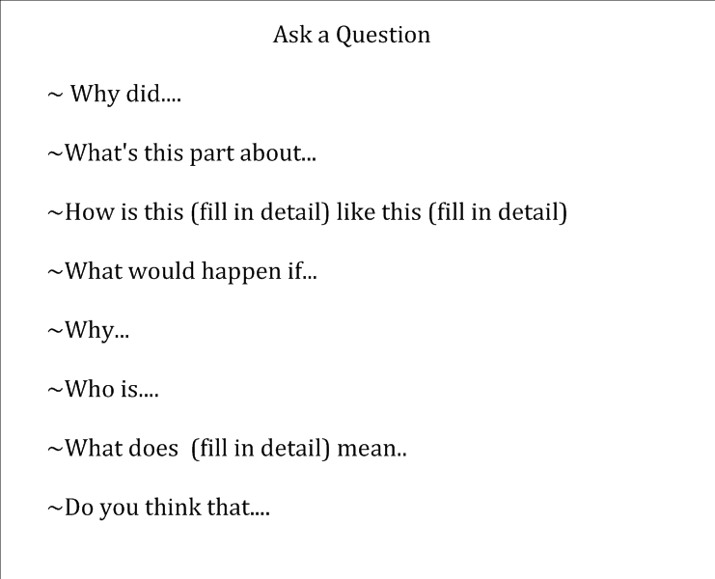

Slide 8
Prediction Starters
~I predict that.....
~I bet that...
~I think that.....
~ Since this happened (fill in the detail), then I be the next thing that is going to happen is.....
~Reading (fill in the detail) makes me think that this (fill in the detail) will happen.....
~ I wonder if.....

Slide 10
Connection Starters
~ This reminds me of....
~This part is like.....
~This character (fill in name) is like (fill in name) because....
~This is similar to....
~ I also (name something in the text that has happened to you)....
~This character makes me think of...
~This setting reminds me of....

